Slide 1





Module 01 – Advanced techniques
WWW.SELACLOUD.COM

Slide 2

Agenda
Lambda functions
Filter and map
is and id
Decorators
Iterators and itertools
Generators
Garbage collector
Random

Slide 3
Lambda
Python supports the creation of anonymous functions (i.e. functions that are not bound to a name) at runtime, using a construct caked “lambda”
This is a very powerful concept that well integrated into Python
The most common use of lambda functions is as callback
Notes:
Python is dynamically-typed and garbage-collected. It supports multiple programming paradigms, including structured (particularly, procedural), object-oriented and functional programming.
It was built to be as readable as possible, and is significant indentation driven (Off-side rule).
The language's core philosophy is summarized in the document The Zen of Python (PEP 20), which includes aphorisms such as:
Beautiful is better than ugly.
Explicit is better than implicit.
Simple is better than complex.
Complex is better than complicated.
Readability counts.
For further reading:
Python (programming language) - Wikipedia

Slide 4
Lambda definition
def f(x):
return x**2
print(f(8)) # print 64
g= lambda x: x**2
print(g(8)) #print 64
Function handler
Function parameters
Function body
Notes:
Python is dynamically-typed and garbage-collected. It supports multiple programming paradigms, including structured (particularly, procedural), object-oriented and functional programming.
It was built to be as readable as possible, and is significant indentation driven (Off-side rule).
The language's core philosophy is summarized in the document The Zen of Python (PEP 20), which includes aphorisms such as:
Beautiful is better than ugly.
Explicit is better than implicit.
Simple is better than complex.
Complex is better than complicated.
Readability counts.
For further reading:
Python (programming language) - Wikipedia

Slide 5
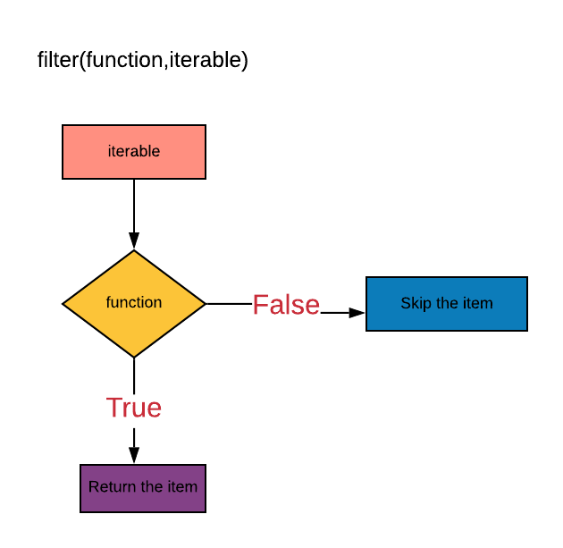
Filter function
resultiter =filter(function, iterable)
filter function returns an iterator of elements of iterable for which function returns true.
iterable may be either a sequence or an iterator
The filter iterates through all elements of iterable, sends them(one by one) to function and includes in resultiter only elements for which the function returns True
If the function is not None, elements from input iterable will be include in a result only if them evaluates as True

Slide 6
Filter function

Slide 7
filter function — demo
For example:
list= [2, 18, 9, 22, 17, 24, 8, 12, 27] seq = filter(lambda x: x % 3 == 0, list) for val in seq: print(val) #18,9, 24,12,27 seq = filter(lambda x: x < 0, range(-5,5)) for val in seq: print(val) #-5, -4, -3, -2,-1

Slide 8
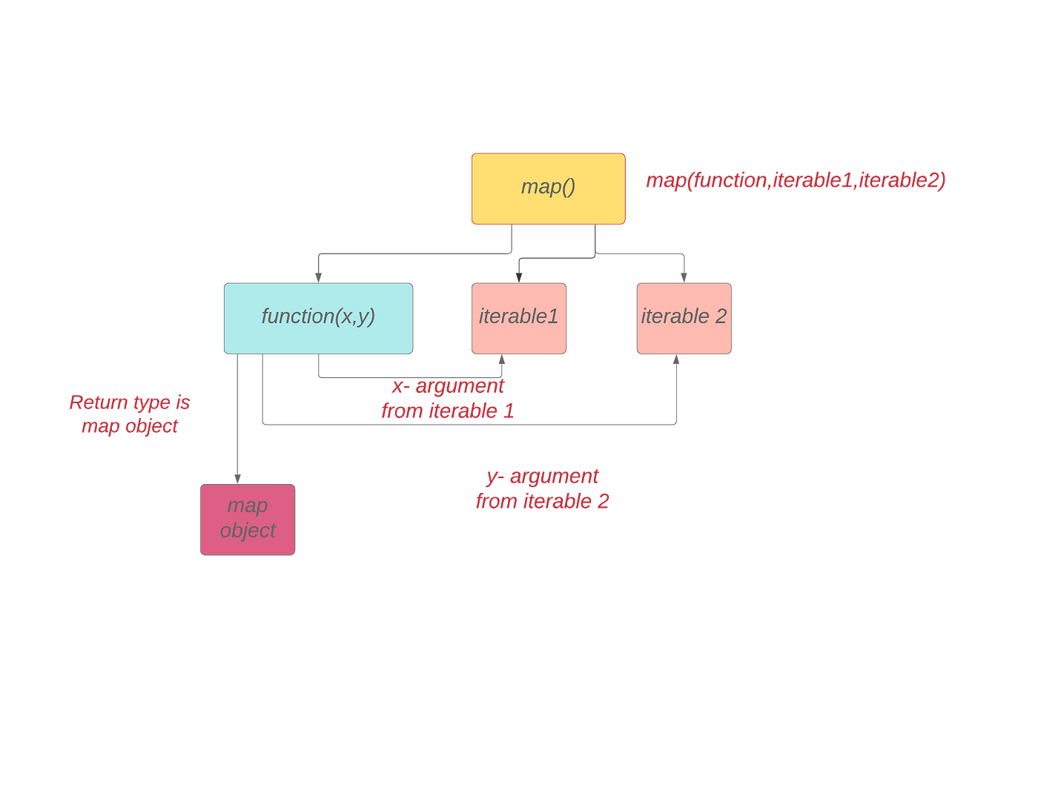
map function
resultlter = map(function, iterable, [iterables])
Return an iterator that applies function to every item of iterable.
* If additional iterables arguments are passed, function must take that many arguments and is applied to the items from all iterables corresponding
— If the number of items in all iterables is not even, the map function y will only iterate through the common items, in python 3 (the number of iterations is defined by minimal sequence length) F
In python 2, the map function iterates through all items and sends | None for absent correspondings (the number of iterations is defined by maximal sequence length
Notes:
PyCharm is currently one of the most used IDE for python development, It provides code analysis, a graphical debugger, an integrated unit tester, integration with version control systems (VCSes), and supports web development with Django as well as data science with Anaconda.
It was created by JetBrains
It is mostly popular because of many things, such as:
It is considered as an intelligent code editor, fast and safe refactoring, and smart code.
Features for debugging, profiling, remote development, testing the code, auto code completion, quick fixing, error detection and tools of the database.
Support for Popular web technologies, web frameworks, scientific libraries and version control.

Slide 9
Map function

Slide 10
map function – cont'd
For Example:
list = [2, 18, 9, 22, 17, 24, 8, 12, 27] map(lambda x: x * 2 + 10, list) # 14, 46, 28,54, 44, 58, 26,34, 64 map(lambda w: len(w), 'A lot of cats and dogs here'.split()) # 1,3,2,4,3,4,4 map(pow, [2, 3, 4], [10, 5, 1, 3]) # 1024,243,4
Notes:
PyCharm is currently one of the most used IDE for python development, It provides code analysis, a graphical debugger, an integrated unit tester, integration with version control systems (VCSes), and supports web development with Django as well as data science with Anaconda.
It was created by JetBrains
It is mostly popular because of many things, such as:
It is considered as an intelligent code editor, fast and safe refactoring, and smart code.
Features for debugging, profiling, remote development, testing the code, auto code completion, quick fixing, error detection and tools of the database.
Support for Popular web technologies, web frameworks, scientific libraries and version control.

Slide 11
Equality (==) and is
is operator checks whether 2 arguments refer to the same object
== operator checks whether 2 arguments have the same value
Notes:
PyCharm is currently one of the most used IDE for python development, It provides code analysis, a graphical debugger, an integrated unit tester, integration with version control systems (VCSes), and supports web development with Django as well as data science with Anaconda.
It was created by JetBrains
It is mostly popular because of many things, such as:
It is considered as an intelligent code editor, fast and safe refactoring, and smart code.
Features for debugging, profiling, remote development, testing the code, auto code completion, quick fixing, error detection and tools of the database.
Support for Popular web technologies, web frameworks, scientific libraries and version control.

Slide 12
Equality (==) and is - cont’d
Numbers:
v1 = 10 v2 = 10 v1 == v2 # compare values, return True v1 is v2 # probably reference to the same object, so True print(id(v1), id(v2)) #30779644, 30779644 v3 = 10 v4=11 v3 +=1 v1 == v2 # compare values, return True v1 is v2 # probably reference to the same object, so True print(id(v3), id(v4)) #30779632, 3077963
Notes:
PyCharm is currently one of the most used IDE for python development, It provides code analysis, a graphical debugger, an integrated unit tester, integration with version control systems (VCSes), and supports web development with Django as well as data science with Anaconda.
It was created by JetBrains
It is mostly popular because of many things, such as:
It is considered as an intelligent code editor, fast and safe refactoring, and smart code.
Features for debugging, profiling, remote development, testing the code, auto code completion, quick fixing, error detection and tools of the database.
Support for Popular web technologies, web frameworks, scientific libraries and version control.

Slide 13
Equality (==) and is - cont’d
This kind of memory sharing we can in the following types as well:
— string
— bool
— None
vi ='aaa'; v2 = 'aaa’
v1 == v2 # compare values, return True
v1 is v2 # probably reference to the same object,so True
x = True
y = True
x is y # probably reference to the same object, so True
Notes:
PyCharm is currently one of the most used IDE for python development, It provides code analysis, a graphical debugger, an integrated unit tester, integration with version control systems (VCSes), and supports web development with Django as well as data science with Anaconda.
It was created by JetBrains
It is mostly popular because of many things, such as:
It is considered as an intelligent code editor, fast and safe refactoring, and smart code.
Features for debugging, profiling, remote development, testing the code, auto code completion, quick fixing, error detection and tools of the database.
Support for Popular web technologies, web frameworks, scientific libraries and version control.

Slide 14
is and id keywords — cont'd
unlike the immutable, python will never referee two different mutable objects to the same memory
For example:
v1 = [1,2,3]; v2 = [1,2,3] v1 == v2 # compare values, return True v1 is v2 # reference to different object, so False v3=v1 v1 == v3 # compare values, return True v1 is v3 # reference to the same object, so True
Notes:
PyCharm is currently one of the most used IDE for python development, It provides code analysis, a graphical debugger, an integrated unit tester, integration with version control systems (VCSes), and supports web development with Django as well as data science with Anaconda.
It was created by JetBrains
It is mostly popular because of many things, such as:
It is considered as an intelligent code editor, fast and safe refactoring, and smart code.
Features for debugging, profiling, remote development, testing the code, auto code completion, quick fixing, error detection and tools of the database.
Support for Popular web technologies, web frameworks, scientific libraries and version control.

Slide 15
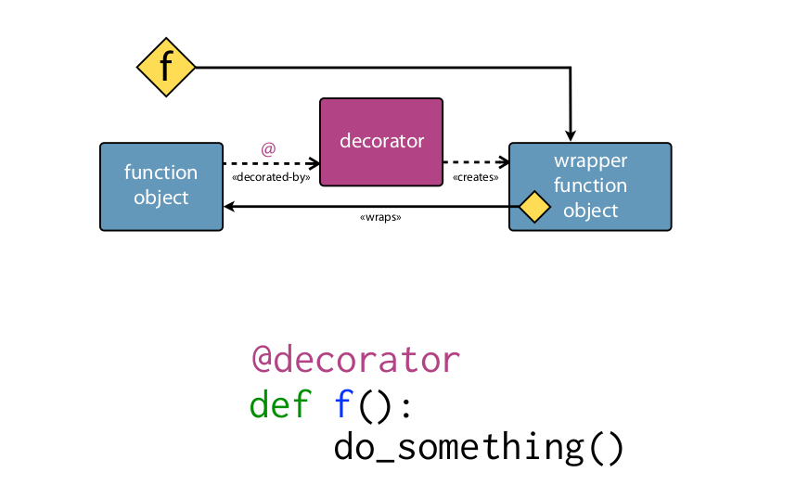
Decorators
Decorator is a feature that extends the functionality of functions without modify it
Built-in python decorators are @staticmethod and @classmethod
@classmethod
— The classmethod decorator decorates methods as static methods, like staticmethod. Not like staticmethod, the classmethod receives the class object as the first parameter.
@staticmethod
— The staticmethod decorator modifies a method so that it.does not use the self variable. Static method do not have access to any attribute of a specific instance of the class.
Notes:
PyCharm is currently one of the most used IDE for python development, It provides code analysis, a graphical debugger, an integrated unit tester, integration with version control systems (VCSes), and supports web development with Django as well as data science with Anaconda.
It was created by JetBrains
It is mostly popular because of many things, such as:
It is considered as an intelligent code editor, fast and safe refactoring, and smart code.
Features for debugging, profiling, remote development, testing the code, auto code completion, quick fixing, error detection and tools of the database.
Support for Popular web technologies, web frameworks, scientific libraries and version control.

Slide 16
Decorators

Slide 17
Built in decorators - Example
class Date(object): def __init__(self, day=1, month=1, year=1970): self.day = day self.month = month self.year = year @classmethod def from_string(cls, date_as_string): day, month, year = map(lambda val: int(val), date_as_string.split('-')) date1 = cls(day, month, year) return date1 @staticmethod def is_date_valid(date_as_string): day, month, year = map(lambda val: int(val), date_as_string.split('-')) return day <= 31 and month <= 12 and year <= 3999

Slide 18
Composition of Decorators
Define functions inside other functions
# Outputs: Hello David
def print_hello(name): def message(): return "Hello " result = message() + name return result print(print_hello ("David"))

Slide 19
Composition of Decorators

Slide 20
Composition of Decorators — cont’d
Functions can be passed as parameters to other functions
Functions can return other functions
def message(name): return "Hello" + name def print_message(func): print(func("David")) def bye_message(): def goodbye_message(name): return "Goodbye" + name return goodbye_message print(print_message (message)) # Outputs: Hello David bye_func = bye_message() bye_func("David") # Outputs: Goodbye David
Notes:
This is the main screen for opening a new project, all project are "of the same type" but not really.
We can choose our projects name by changing the last section of the location box
We can choose different environments like Virtualenv(the base one here), or Conda.
Also, we can use a new (base) interpreter or just pick one of our previously used ones if we choose so. For beginners this is all we need to know, we want a new interpreter

Slide 21
Composition of Decorators — cont’d
Function decorators are simply wrappers to existing functions.
In this example let's consider a function that substitute space sequences by single space in output string of another function.
import re def get_text(name): return "long sentence for {0} ".format(name) def squeeze_space (func): def squeezer(name): str=func(name) return re.sub(r' +', ' ', str) return squeezer get_text = squeeze_space(get_text) print(get_text ("John")) # prints "long sentence for John" def squeeze_space (func): def squeezer(name): str=func(name) return re.sub(r' +', ' ', str) return squeezer @squeeze_space def get_text(name): return "long sentence for {0} ".format(name) print(get_text("John")) # prints "long sentence for John"
Notes:
This is the main work area in PyCharm: The Coding section is where you write you code
Menu bar is all the options, setting etc.
Project explorer is where all of our current project files and folders are located, we can navigate between them there
The tools are our main uses, like the console, terminal, debug section, etc.
The run script section is where we run our current open script, of course our script can run our entire project, depends on what's connected to the script we are running

Slide 22
Passing arguments to decorators
Suppose we want different functions to squeeze custom character
import re def squeeze_char(ch): def squeeze_repeat(func): def squeezer(name): str = func(name) return re.sub("{}+".format(ch), ch, str) return squeezer return squeeze_repeat @squeeze_char("") def get_text(name): return "long sentence for {0} ".format(name) @squeeze_char("\n") def parse_text(text): # …… print(get_text("John")) # prints "long sentence for John"
Notes:
This is the main work area in PyCharm: The Coding section is where you write you code
Menu bar is all the options, setting etc.
Project explorer is where all of our current project files and folders are located, we can navigate between them there
The tools are our main uses, like the console, terminal, debug section, etc.
The run script section is where we run our current open script, of course our script can run our entire project, depends on what's connected to the script we are running

Slide 23
Special method names
A class can implement certain operations that are invoked by special syntax (such as arithmetic operations or iterating) by defining methods with special names.
Using special methods, your classes can act like sets, like dictionaries, like functions, like iterators, or even like numbers
Notes:
This is the main work area in PyCharm: The Coding section is where you write you code
Menu bar is all the options, setting etc.
Project explorer is where all of our current project files and folders are located, we can navigate between them there
The tools are our main uses, like the console, terminal, debug section, etc.
The run script section is where we run our current open script, of course our script can run our entire project, depends on what's connected to the script we are running

Slide 24
Overload operators -__str__
__str__ returns the string representation of an object
__str__ function can be placed in classes and it is used implicitly in string context like str() or print
class Fraction: def __init__(self, numerator, denominator): self.numerator = numerator self.denominator = denominator def __str__(self): return "{0}/{}".format(self.numerator, self.denominator) f = Fraction(1,2) print (f) # print 1/2
Notes:
This is the main work area in PyCharm: The Coding section is where you write you code
Menu bar is all the options, setting etc.
Project explorer is where all of our current project files and folders are located, we can navigate between them there
The tools are our main uses, like the console, terminal, debug section, etc.
The run script section is where we run our current open script, of course our script can run our entire project, depends on what's connected to the script we are running

Slide 25
Overload operators - Comparing objects
object.__It__(self, other) called for x<y
object.__le__ (self, other) called for x<=y
object.__eq__(self, other) called for x==y
object. __ne__(self, other) called for x!=y
object. __gt__(self, other) called for x>y
object. __ge__(self, other) called for x>=y
class Fraction: # .... def __lt__(self, other): return (self.numerator * other.denominator) < (other.numerator * self.denominator) def __ge__(self, other): return not (self < other)

Slide 26
Overload operators - Comparing objects — cont’d
f1= Fraction(1,2)
f2 = Fraction(1,3)
print(f2 < f1) # print True
print(f1 >= f2) # print True
Notes:
The Python console has two main methods: print and input.
Print, like its name, prints whatever is between the brackets, sometimes things might not be printed like we think they will (like Classes instances), we will see them as we progress. Input, like its name, receives an input from the user in the console, and we can of course use them to do different things (inputs are always of type string! Remember that!)

Slide 27
Overload operators — more examples
There are much more operator overloading functions like:
__iter__ for iterating through — will be discussed later
__hash__ called on items insertion to dictionary
__len__ - to support the /en built-in function
__contains___ - to support in operator
__nonzero__ called to implement truth value while testing the built-in operation bool() or boolean context
__add__, __sub__, __ mul__, __ floordiv__, __mod__ for arithmetic operations
__enter__ and__exit__ - to implement context manager
And much more...
Notes:
The Python console has two main methods: print and input.
Print, like its name, prints whatever is between the brackets, sometimes things might not be printed like we think they will (like Classes instances), we will see them as we progress. Input, like its name, receives an input from the user in the console, and we can of course use them to do different things (inputs are always of type string! Remember that!)

Slide 28
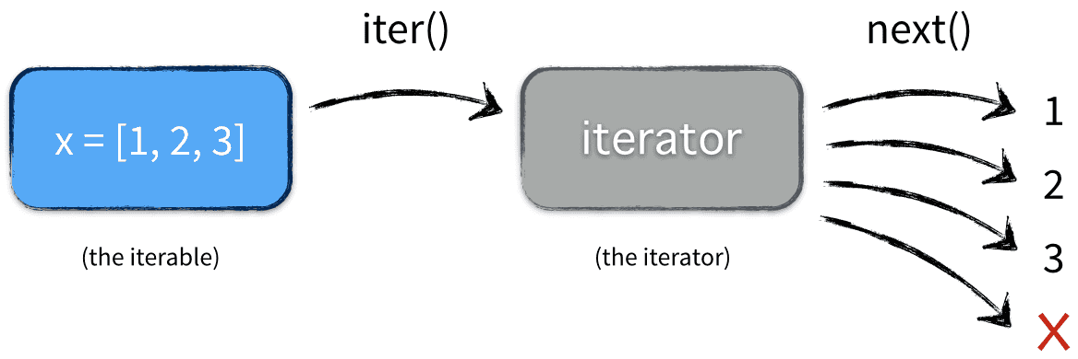
Iterators
Iterator is an objects that can be used to go through all its items (with a for loop for example)
For example:
for i in [1,2,3,4]: or for i in "python": or for i in open("file.txt"):
print(i)
There are many functions which consume these iterables:
for loop
sum, min, max built-in functions
filter and map built-in functions
Comprehension
Type conversions to python sequence
etc

Slide 29
The Iterator Protocol
In order to become an iterable object our class should implement the following protocol:
— It should implement __iter__ function that returns an iterator
— The iterator should implement __next__ function that gives us the next element each time we call it.
__next__ method of python 3, implemented as next method in, python 2
The built-in function iter takes an iterable object and returns an iterator. Most iter function invocations are implicit, by i Z iterator consumers

Slide 30
The Iterator Protocol — cont’d
Traceback (most recent call last):
File "<stdin>", line 5, in <module>
Stoplteration
it = iter([1, 2, 3]) print(it) # prints <listiterator object at Ox1004ca850> print( it.__next__()) # prints 1 print( it. __next__()) # prints 2 print( it.__next__()) # prints 3 print( it.__next__())

Slide 31
The Iterator Protocol V1

Slide 32
Implement Iterator — Version 1
class Yrange: def __init__(self, n): self.i = 0 self.in =n def __iter__ (self): return self def __next__(self): if self.i < self.n: self.i += 1 return self.i-1 else: raise Stoplteration()

Slide 33
Implement Iterator — Version 2
class Zrange_iter: def __init__(self, n): self.i = 0 self.n = n def __next__(self): if self.i < self.n: self.i += 1 return self.i - 1 else: raise StopIteration() class Zrange: def __init__(self, n): self.n = n def __iter__(self): return Zrange_iter(self.n)

Slide 34
Iterators consumers
y = Yrange(5) print(list(y)) # prints [0, 1, 2, 3, 4] print(list(y)) # prints [] z = Zrange(5) print(list(z)) # prints [0, 1, 2, 3, 4] print(list(z)) # prints [0, 1, 2, 3, 4] print(sum(z)) # prints 10 l1 = [x * 10 for x in z] # l1 = [0, 10, 20, 30, 40] l2 = filter(lambda n: n % 2, z) # l2 = [1, 3]

Slide 35
Itertools
The itertools module in Python provides functions for working with iterators efficiently. It offers a range of tools that can be used individually or combined to perform complex operations on iterators. These tools are designed to be fast and memory-efficient.
For example, suppose you have two lists and you want to multiply their elements. There are different ways to achieve this. One approach is to iterate through the elements of both lists simultaneously and multiply them. Another approach is to use the map function with the mul operator and the two lists as arguments. Let's compare the execution time of each approach.

Slide 36
Itertools – cont’d
Different types of iterators provided by this module are:
Infinite iterators
Combinatoric iterators
Terminating iterators

Slide 37
Itertools – Infinite iterators
Iterator in Python is any Python type that can be used with a ‘for in loop’. Python lists, tuples, dictionaries, and sets are all examples of inbuilt iterators. But it is not necessary that an iterator object has to exhaust, sometimes it can be infinite. Such types of iterators are known as Infinite iterators.
Python provides three types of infinite iterators:
count(start, step): This iterator starts printing from the “start” number and prints infinitely. If steps are mentioned, the numbers are skipped else step is 1 by default. See the below example for its use with for in loop.

Slide 38
Infinite iterators examples

Slide 39
Infinite iterators examples
cycle(iterable): This iterator prints all values in order from the passed container. It restarts printing from the beginning again when all elements are printed in a cyclic manner.
# Python program to demonstrate # infinite iterators import itertools count = 0 # for in loop for i in itertools.cycle('AB'): if count > 7: break else: print(i, end=" ") count += 1

Slide 40
Infinite iterators examples – cont’d
repeat(val, num): This iterator repeatedly prints the passed value an infinite number of times. If the optional keyword num is mentioned, then it repeatedly prints num number of times.
# Python code to demonstrate the working of # repeat() # importing "itertools" for iterator operations import itertools # using repeat() to repeatedly print number print("Printing the numbers repeatedly : ") print(list(itertools.repeat(25, 4)))

Slide 41
Itertools – Combinatoric iterators
The recursive generators that are used to simplify combinatorial constructs such as permutations, combinations, and Cartesian products are called combinatoric iterators.
In Python there are 4 combinatoric iterators:
Product(): This tool computes the cartesian product of input iterables. To compute the product of an iterable with itself, we use the optional repeat keyword argument to specify the number of repetitions. The output of this function is tuples in sorted order.

Slide 42
Combinatoric iterators examples

Slide 43
Combinatoric combinatoric iterators
Permutations(): Permutations() as the name speaks for itself is used to generate all possible permutations of an iterable. All elements are treated as unique based on their position and not their values. This function takes an iterable and group_size, if the value of group_size is not specified or is equal to None then the value of group_size becomes the length of the iterable.
# import the product function from itertools module from itertools import permutations print("All the permutations of the given list is:") print(list(permutations([1, 'geeks'], 2))) print() print("All the permutations of the given string is:") print(list(permutations('AB'))) print() print("All the permutations of the given container is:") print(list(permutations(range(3), 2)))

Slide 44
Combinatoric combinatoric iterators
Combinations(): This iterator prints all the possible combinations(without replacement) of the container passed in arguments in the specified group size in sorted order.
# import combinations from itertools module from itertools import combinations print("All the combination of list in sorted order(without replacement) is:") print(list(combinations(['A', 2], 2))) print() print("All the combination of string in sorted order(without replacement) is:") print(list(combinations('AB', 2))) print() print("All the combination of list in sorted order(without replacement) is:") print(list(combinations(range(2), 1)))

Slide 45
Combinatoric combinatoric iterators
Combinations_with_replacement(): This function returns a subsequence of length n from the elements of the iterable where n is the argument that the function takes determining the length of the subsequences generated by the function. Individual elements may repeat itself in combinations_with_replacement function.
# import combinations from itertools module from itertools import combinations_with_replacement print("All the combination of string in sorted order(with replacement) is:") print(list(combinations_with_replacement("AB", 2))) print() print("All the combination of list in sorted order(with replacement) is:") print(list(combinations_with_replacement([1, 2], 2))) print() print("All the combination of container in sorted order(with replacement) is:") print(list(combinations_with_replacement(range(2), 1)))

Slide 46
Itertools – Terminating iterators
Terminating iterators are used to work on the short input sequences and produce the output based on the functionality of the method used.
Different types of terminating iterators are:
accumulate(iter, func): This iterator takes two arguments, iterable target and the function which would be followed at each iteration of value in target. If no function is passed, addition takes place by default. If the input iterable is empty, the output iterable will also be empty.

Slide 47
Terminating iterators examples

Slide 48

Terminating iterators examples
chain(iter1, iter2..): This function is used to print all the values in iterable targets one after another mentioned in its arguments.
chain.from_iterable(): This function is implemented similarly as a chain() but the argument here is a list of lists or any other iterable container.
# Python code to demonstrate the working of # and chain() import itertools # initializing list 1 li1 = [1, 4, 5, 7] # initializing list 2 li2 = [1, 6, 5, 9] # initializing list 3 li3 = [8, 10, 5, 4] # using chain() to print all elements of lists print("All values in mentioned chain are : ", end="") print(list(itertools.chain(li1, li2, li3)))
# Python code to demonstrate the working of # chain.from_iterable() import itertools # initializing list 1 li1 = [1, 4, 5, 7] # initializing list 2 li2 = [1, 6, 5, 9] # initializing list 3 li3 = [8, 10, 5, 4] # initializing list of list li4 = [li1, li2, li3] # using chain.from_iterable() to print all elements of lists print("All values in mentioned chain are : ", end="") print(list(itertools.chain.from_iterable(li4)))

Slide 49
Terminating iterators examples
compress(iter, selector): This iterator selectively picks the values to print from the passed container according to the boolean list value passed as other arguments. The arguments corresponding to boolean true are printed else all are skipped.
dropwhile(func, seq): This iterator starts printing the characters only after the func. in argument returns false for the first time.
# Python code to demonstrate the working of # and compress() import itertools # using compress() selectively print data values print("The compressed values in string are : ", end="") print(list(itertools.compress('GEEKSFORGEEKS', [ 1, 0, 0, 0, 0, 1, 0, 0, 1, 0, 0, 0, 0])))
# Python code to demonstrate the working of # dropwhile() import itertools # initializing list li = [2, 4, 5, 7, 8] # using dropwhile() to start displaying after condition is false print("The values after condition returns false : ", end="") print(list(itertools.dropwhile(lambda x: x % 2 == 0, li)))

Slide 50
Terminating iterators examples
filterfalse(func, seq): As the name suggests, this iterator prints only values that return false for the passed function.
islice(iterable, start, stop, step): This iterator selectively prints the values mentioned in its iterable container passed as argument. This iterator takes 4 arguments, iterable container, starting pos., ending position and step.
# Python code to demonstrate the working of # filterfalse() import itertools # initializing list li = [2, 4, 5, 7, 8] # using filterfalse() to print false values print("The values that return false to function are : ", end="") print(list(itertools.filterfalse(lambda x: x % 2 == 0, li)))
# Python code to demonstrate the working of # islice() import itertools # initializing list li = [2, 4, 5, 7, 8, 10, 20] # using islice() to slice the list acc. to need # starts printing from 2nd index till 6th skipping 2 print("The sliced list values are : ", end="") print(list(itertools.islice(li, 1, 6, 2)))

Slide 51
Terminating iterators examples
starmap(func., tuple list): This iterator takes a function and tuple list as argument and returns the value according to the function from each tuple of the list.
takewhile(func, iterable): This iterator is the opposite of dropwhile(), it prints the values till the function returns false for 1st time.
# Python code to demonstrate the working of # starmap() import itertools # initializing tuple list li = [(1, 10, 5), (8, 4, 1), (5, 4, 9), (11, 10, 1)] # using starmap() for selection value acc. to function # selects min of all tuple values print("The values acc. to function are : ", end="") print(list(itertools.starmap(min, li)))
# Python code to demonstrate the working of # takewhile() import itertools # initializing list li = [2, 4, 6, 7, 8, 10, 20] # using takewhile() to print values till condition is false. print("The list values till 1st false value are : ", end="") print(list(itertools.takewhile(lambda x: x % 2 == 0, li)))

Slide 52
Terminating iterators examples
tee(iterator, count):- This iterator splits the container into a number of iterators mentioned in the argument.
zip_longest( iterable1, iterable2, fillval): This iterator prints the values of iterables alternatively in sequence. If one of the iterables is printed fully, the remaining values are filled by the values assigned to fillvalue.
# Python code to demonstrate the working of # tee() import itertools # initializing list li = [2, 4, 6, 7, 8, 10, 20] # storing list in iterator iti = iter(li) # using tee() to make a list of iterators # makes list of 3 iterators having same values. it = itertools.tee(iti, 3) # printing the values of iterators print("The iterators are : ") for i in range(0, 3): print(list(it[i]))
# Python code to demonstrate the working of # zip_longest() import itertools # using zip_longest() to combine two iterables. print("The combined values of iterables is : ") print(*(itertools.zip_longest('GesoGes', 'ekfrek', fillvalue='_')))

Slide 53
Generators
Generators are functions allow as to declare a function that behaves like an iterator, i.e. it can be used in a for loop
Generators simplifies creation of iterators. A generator is a function that produces a sequence of results instead of a single value.
Generators are functions that have a yield statement

Slide 54
Implement generator

Slide 55
For example:
def gen_range(n): i = 0 while i < n: yield i i +=1 res_iter = gen_range(5) for n in res_iter: print(n)

Slide 56
Generators consumers
def gen(n): for i in range(n+1): yield i print(sum(gen(10))) #55 for el in gen(4): #01234 print (el) first7Values = gen(7) lst = [x*x for x in first7Values] print (lst) #[0149 16 25 36 49]

Slide 57
Python Garbage Collection
Python's memory allocation and deallocation method is automatic.
Python uses two strategies for memory allocation™ reference counting and garbage collection.
Prior to Python version 2.0, the Python interpreter only used reference counting for memory management.

Slide 58
Reference counting
Reference counting works by counting the number of times an object is referenced by other objects in the system.
When references to an object are removed, the reference count for an object is decremented.
When the reference count becomes zero the object is deallocated, including invoking __del__ method on objects
Reference counting is extremely efficient but it does not always works
— One of the biggest problems in reference counting is reference cycles.

Slide 59
Reference counting — reference cycles
A reference cycles prevents from objects’ reference count to drops down to zero, yet there is no way to reach the objects.
For example:
def make_cycle(): l=[] l.append(l) make_cycle()

Slide 60

AGC - Automatic Garbage Collection
The main role of AGC in python is to detect reference cycles for python sequences and user objects and to deallocate them
The automatic garbage collection has been included in Python since version 2.0.
A reference-counting scheme collects objects as soon.as they become unreachable
The time of collection of objects with circular references is unknown.
Do not depend on immediate finalization of objects when” - they become unreachable

Slide 61
Python gc - Manual Garbage Collection
For some programs, especially long running server applications or embedded applications, automatic garbage collection may not be sufficient
The garbage collection can be invoked manually with gc.collect() function, which returns the number of objects it has collected and deallocated

Slide 62
GC example

Slide 63
gc example
import gc def make_cycle(): l = [] l.append(l) def main(): collected = gc.collect() print("Garbage collector: collected {} objects.".format(collected)) print("Creating cycles...") for i in range(10): make_cycle() collected = gc.collect() print("Garbage collector: collected {} objects.".format(collected)) main()

Slide 64
Random
Python's random module provides functions to generate random values. It is commonly used in various applications such as games, simulations, and statistical analysis. Let's explore some commonly used functions:
random.random(): This function returns a random float number between 0 and 1. It is often used when you need a random decimal number for a particular purpose.
import random random_number = random.random() print(random_number)

Slide 65
Random – cont’d
random.randint(a, b): This function returns a random integer between a and b, inclusive. It is useful when you need a random whole number within a specific range.
random.choice(sequence): This function returns a random element from the given sequence, such as a list, tuple, or string. It allows you to select a random item from a collection.
import random random_integer = random.randint(1, 10) print(random_integer)
import random fruits = ['apple', 'banana', 'orange', 'kiwi'] random_fruit = random.choice(fruits) print(random_fruit)

Slide 66
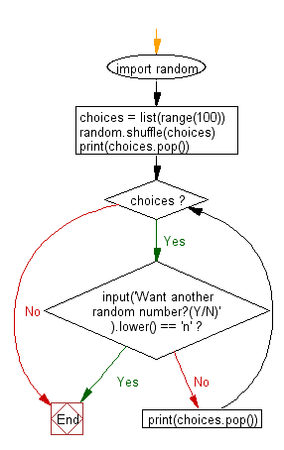
Random – cont’d
random.shuffle(sequence): This function shuffles the elements in the given sequence in-place. It is useful when you want to randomize the order of a list or any other sequence.
These functions are just a glimpse of what the random module offers. There are additional functions available, such as random.uniform(), random.sample(), and random.randrange(), which provide further flexibility in generating random values. By utilizing these functions effectively, students can add randomness to their programs, making them more dynamic and realistic.
import random cards = ['Ace', '2', '3', '4', '5', '6', '7', '8', '9', '10', 'Jack', 'Queen', 'King'] random.shuffle(cards) print(cards)

Slide 67
Lab 01

